Slide 1
Digital Portfolio
STUDENT NAME: S.SUBASHREE
REGISTER NO AND NMID: 4F6B0C6B6A292268CE547667785D4F94
DEPARTMENT: BCA
COLLEGE: AKSHEYAA COLLEGE OF ARTS AND SCIENCE / UNIVERSITY

Slide 2
PROJECT TITLE
⭐ My Resume
Digital Portfolio Development
Design and Implementation of a Digital Portfolio
Web Based Digital Portfolio System
Personal Digital Portfolio Website
Interactive Digital Portfolio

Slide 3


AGENDA
Problem Statement
Project Overview
End Users
Tools and Technologies
Portfolio design and Layout
Features and Functionality
Results and Screenshots
Conclusion
Github Link
3/21/2024 Annual Review

Slide 4

PROBLEM STATEMENT
A normal paper resume is plain and limited in design,which makes it hard to show creativity and stand out. To solve this, I create a digital resume that presents my personal details, skills, education and projects in a clear, attractive, and easily accessible way.

Slide 5

PROJECT OVERVIEW
The project focuses on developing a Digital Portfolio Website to showcase personal details, academic background, technical skills,and project work. The portfolio emphasizes user-friendly design,responsive layout, and interactive elements, enabling viewers to navigate easily and understand the profile.

Slide 6

WHO ARE THE END USERS?
Students & Professionals – To showcase their skills and achievements.
Recruiter’s & Employers – To evaluate candidates ‘capabilities a traditional resume .
Academic Institutions – For student’s project submissions and evaluation.

Slide 7

TOOLS AND TECHNIQUES
Front-end : HTML,CSS,JAVAScript.
Version Control : GitHub
Design tools : Canva ( for layout design)

Slide 8
POTFOLIO DESIGN AND LAYOUT
Home page : Introduction and Banner Section.
About section : Personal Details, Academic Profile.
Skills Section : Technical expertise and Skills.
Content Section : Address, email and phone number.
8

Slide 9
FEATURES AND FUNCTIONALITY
Proper use of fonts,spacing and alignment makes the design professional.
The Layout is simple, attractive, and user- friendly,making the information easy to follow.

Slide 10
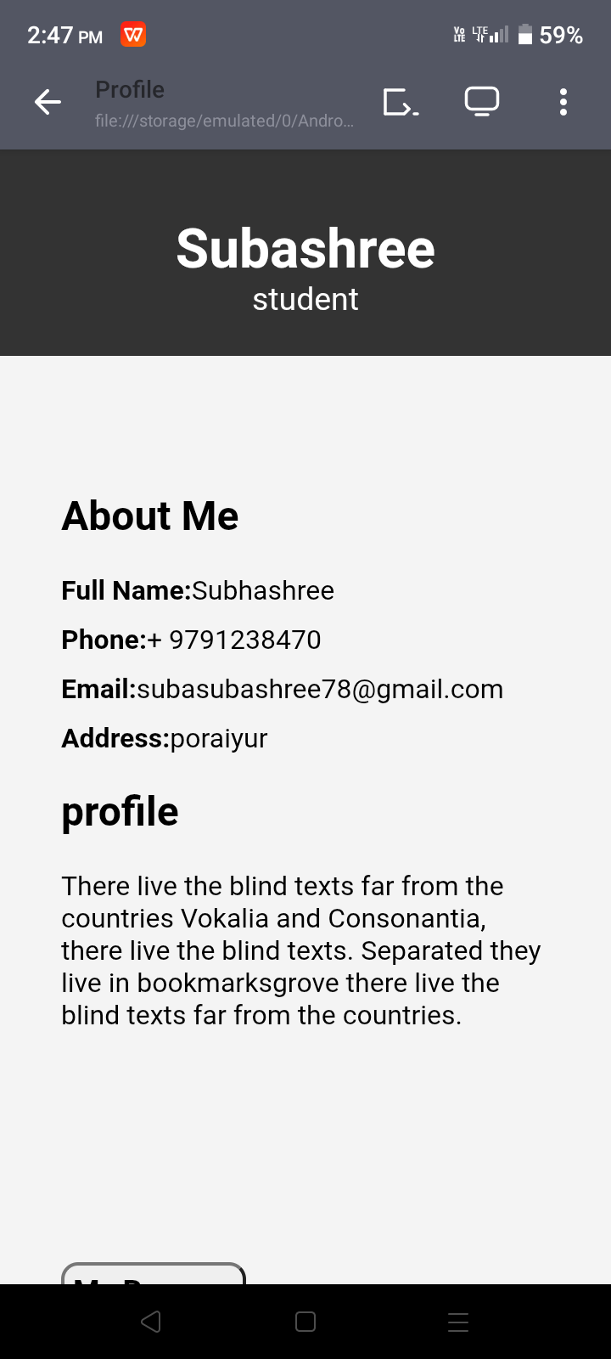
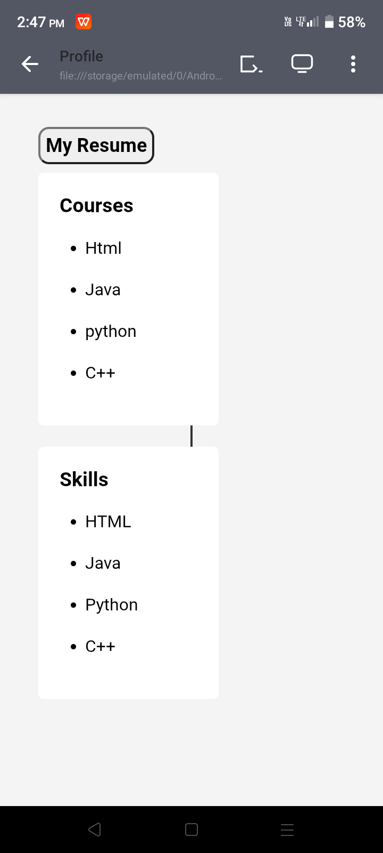
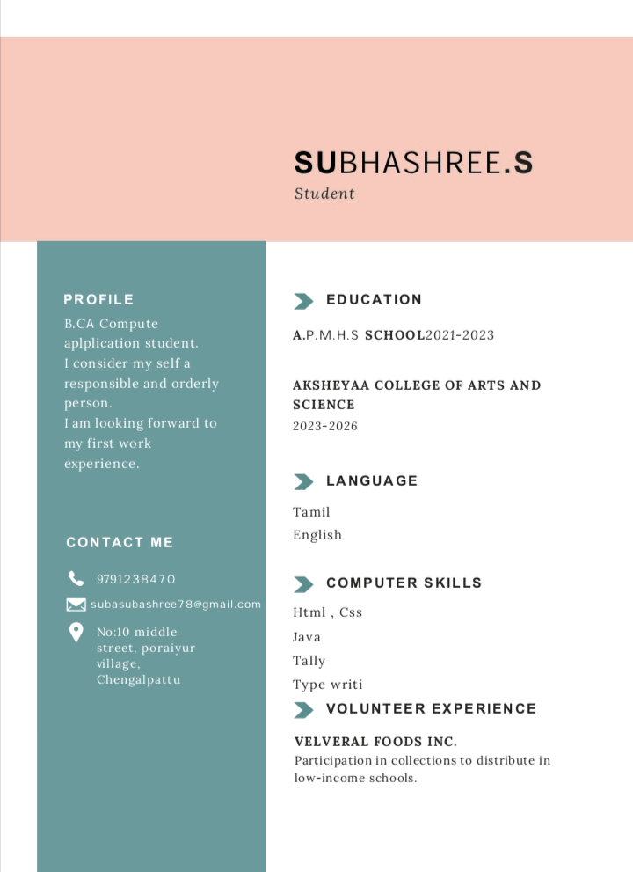

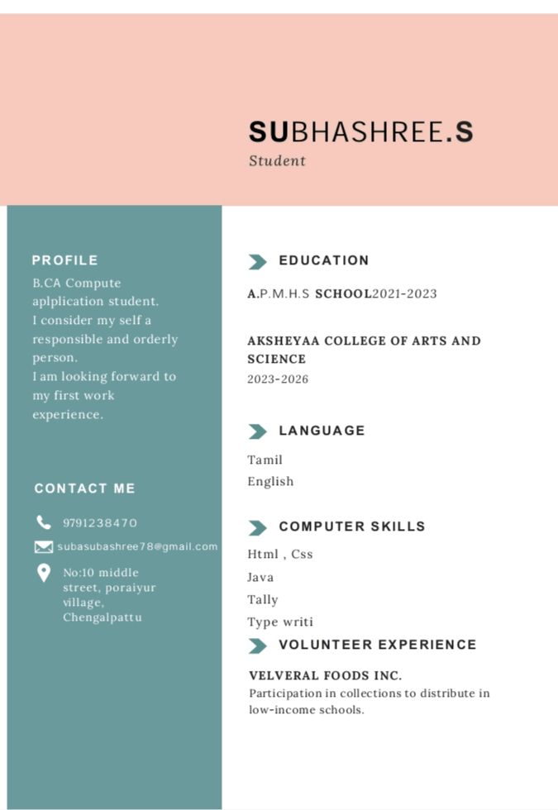
RESULTS AND SCREENSHOTS
3/21/2024 Annual Review
10

Slide 11
CONCLUSION
This project provides a simple and creative way to present details in a digital format. It is easy to update, accessible, and more attractive than a traditional resume.
11

Slide 12
GitHub Link
https://subasubashree78-design.github.io/digital_portfolio/

